Slide 1
Traffic Violation Analysis Project

Slide 2
Traffic Violation data sets has 1,000,000 Rows and 35 Columns After Cleaning and manipulation.
New Data contains:
Columns:25
Rows:9980i
Null:0

Slide 3
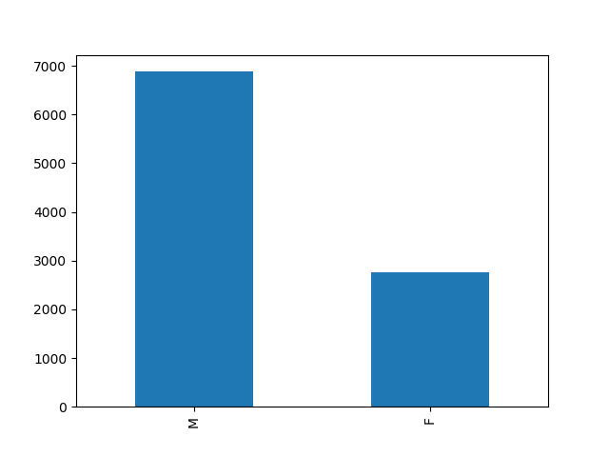
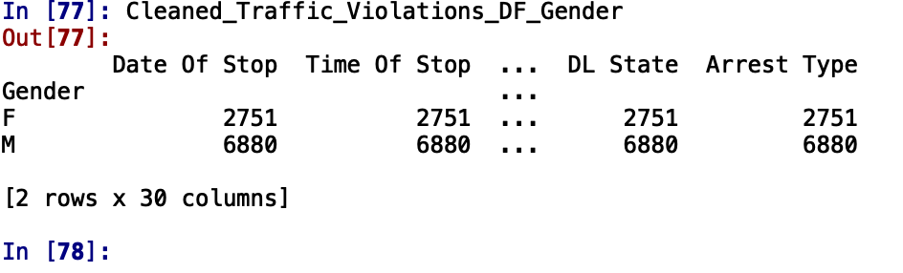
Q1 How many Female and Male the Data Frame has?

Slide 4
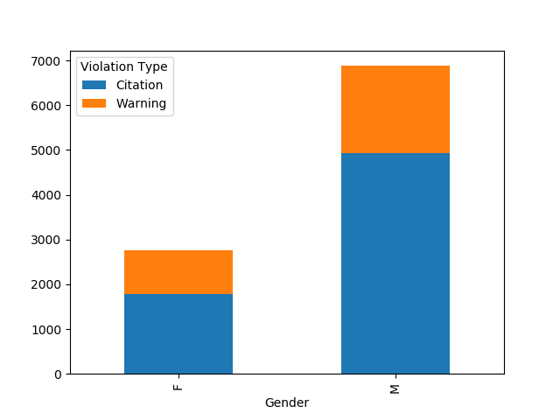
Q2: How many Female , Male who committed Traffic violation and what type it’s

Slide 5
Q3 What is Distribution of the violation type on the data set

Slide 6
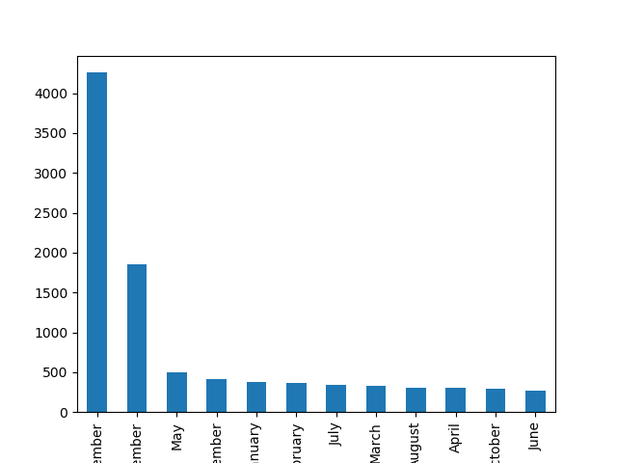
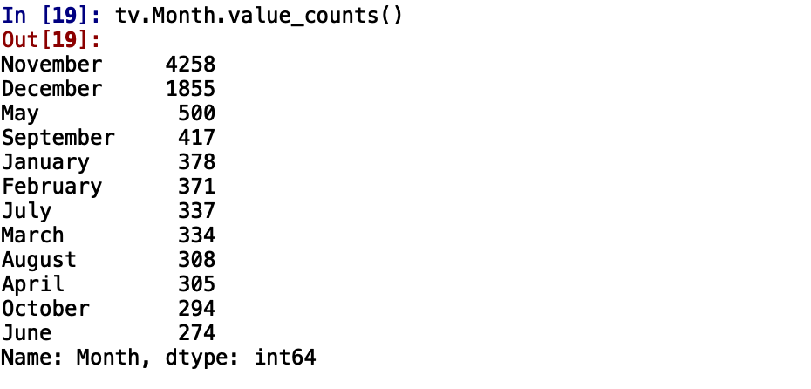
Q 4: which month with most violation occurrence ?

Slide 7
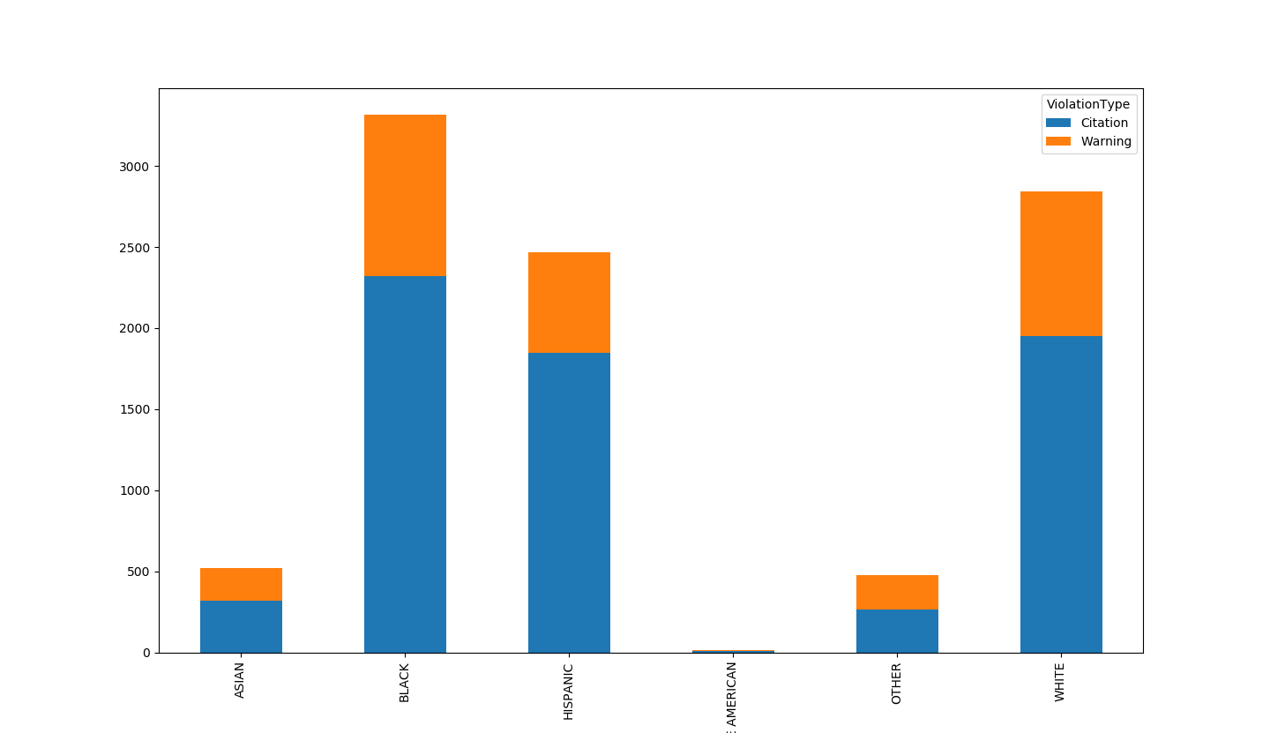
Q:5 what race has most violation committed and what type of violation

Slide 8
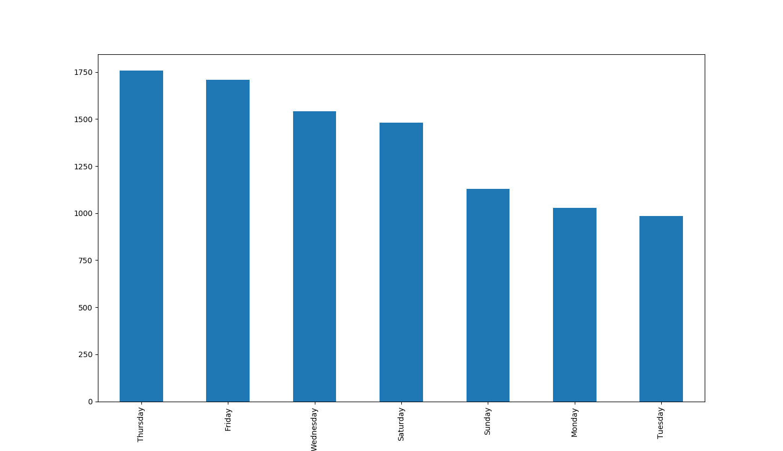
Q6: Which date with most violation after ?

Slide 9
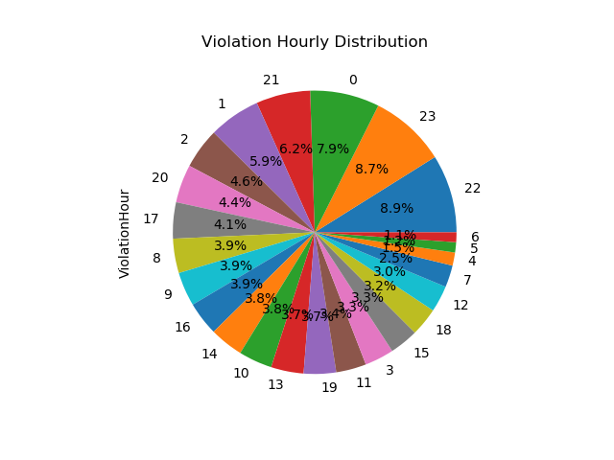
Q7 what is the time where the most violation happened Daytime Afternoon Nighttime?

Slide 10
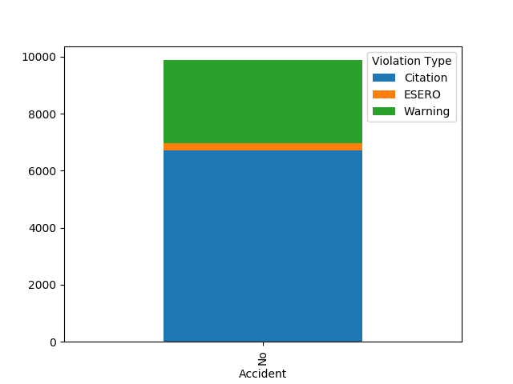
Q 8 how many people have involved in Accident and what type of violation its ?

Slide 11
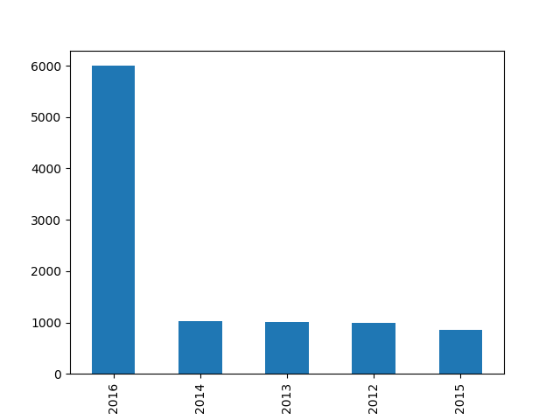
Q 10 which year with most violation?

Slide 12
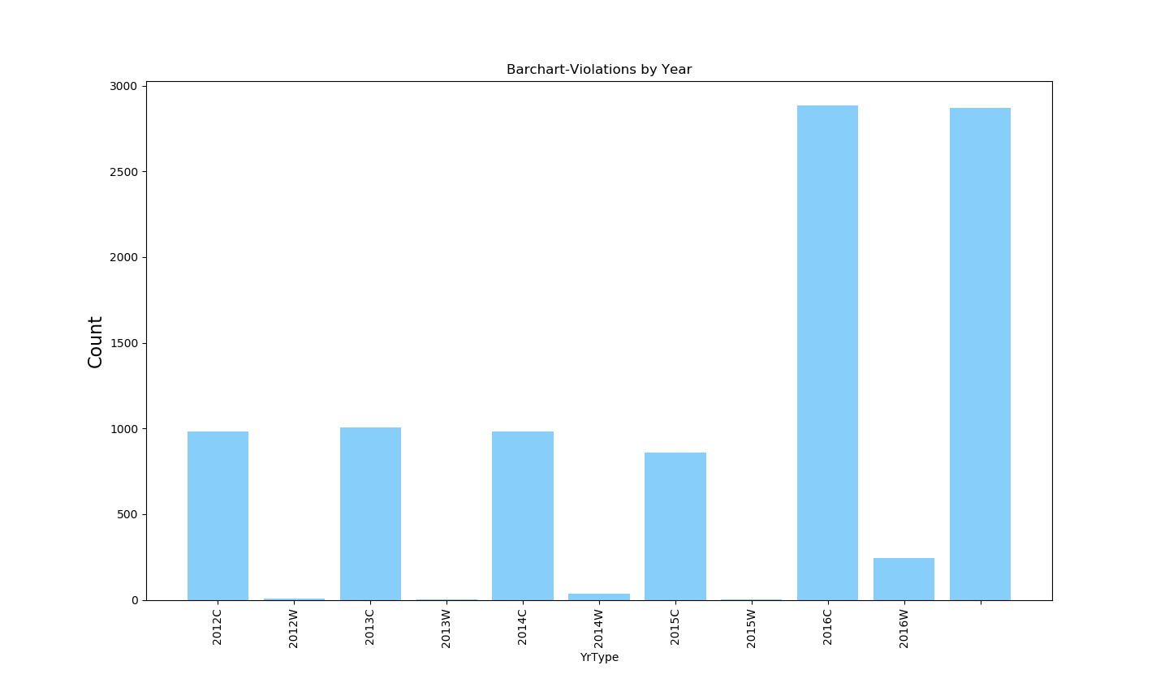
Q 10 which year with most violation type ?

Slide 13
:
Conclusion & Recommendation
Data Set has 2750 Female and 6880 Male
Most committed Traffic violation was made by males but in percentage terms both make and female committed roughly the same level of violations
Most Traffic violation committed by Black Race ‘I'm black never had Traffic Violation ’ White Race come second with 10% differences between the two.
From the data we can establish that the police was not overly harsh as a 3rd of all stoppages let to only a warning being issued rather than a citation.
We see most violations on Thursday and Friday which might be an indication of work week fatigue kicking in.
Moreover, November and December have most violation presumably because of the holiday session and extra vigilance around this time by the police to discourage drunk driving.
Data regarding race shows that despite popular belief, the police were fair handed with handling violations by people form different race groups. Roughly the same percentage of people got citations and warnings with no bias.
As expected most violation occur at night time when the roads are relatively empty make drivers careless and drive faster than they normally would
One of most interested facts is all violations committed no one has involved in an accident !!!!
Data has four years 2012,13,14,15 and 2016 which was the year violation need more investigation specially all others share the same percentage
Of violations committed

